Slide 1
Meet the Teacher
Year 4/5
2026 - 2027

Slide 2
Year 4/5 Team
Head Teacher: Mrs Rebekah Bailey
Teachers: Mrs Rachael Nash & Mrs Sarah Turnham
Teaching Assistants: Mrs Tracey Julian
The best way to get hold of us is a note in the planner or to email the office and they will forward it on to us. And, of course, we have our open door policy.

Slide 3
Year 4/5 Topics
Autumn 1: Why do people live in and visit mountain regions?
Autumn 2: What is life like in different climate zones?
Spring 1: What impact did the Industrial Revolution have on Cornish tin mining?
Spring 2: When and why did the Maya disappear?
Summer 1: Where can we see the influence of Ancient Greece today?
Summer 2: How do rivers impact the lives of people around the world?
Stunning Starts and Fab Finishes!

Slide 4

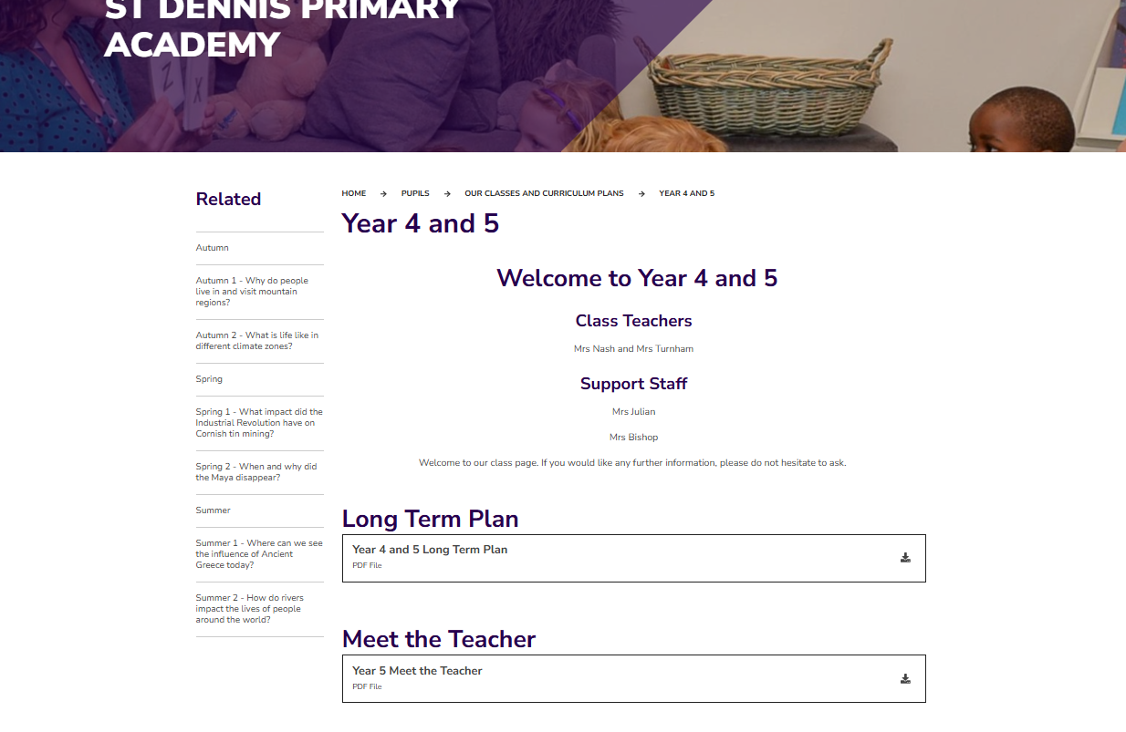
Website
Our class website page has all our plans for the coming term and Knowledge Organisers with key learning. You will also receive a paper copy of these.
St Dennis Primary Academy - Year 4 and 5

Slide 5
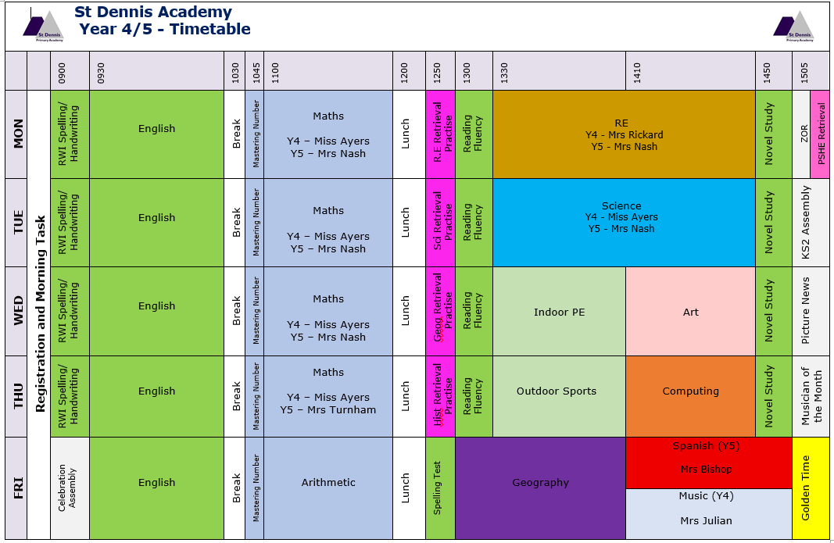
Timetable
Wear PE kit to school on
Wednesdays and Thursday - please wear these clothes to school.
Forest school for year 4s on a Thursday afternoon – bring clothes in a bag to change into.

Slide 6
Special to Year 4/5
Our educational visits are bigger and better this academic year, thanks to funding from the Clore Duffield Foundation. They help children access enriching experiences that they might otherwise not have the opportunity to enjoy. The funding covers the full cost of participating trips.
For our children, this means more opportunities to learn beyond the classroom, experience arts, culture, heritage, science and the natural world, and make memorable experiences together.

Slide 7
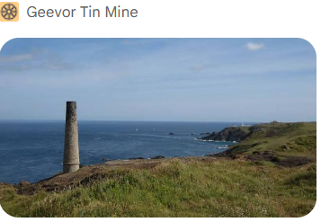
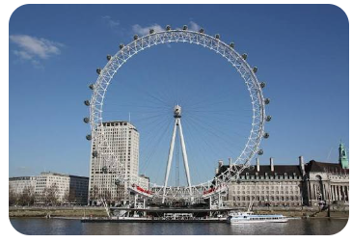



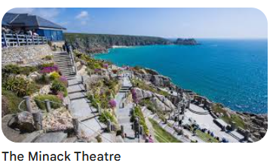
Special to Year 4/5
Our planned visits for 2026–27 include:

Slide 8
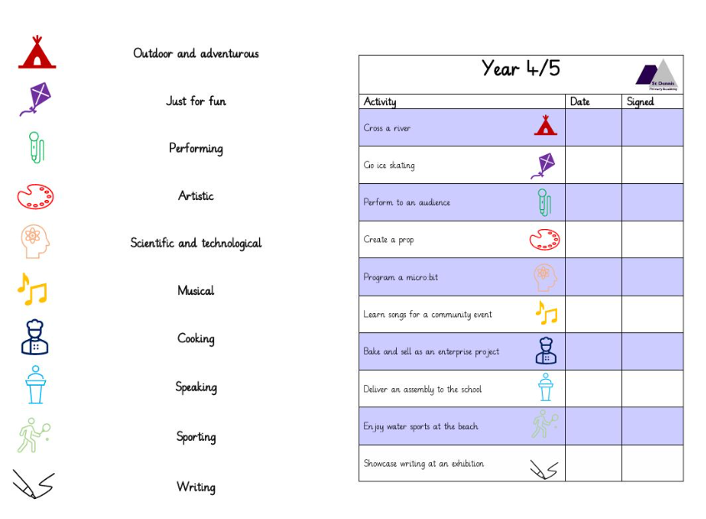
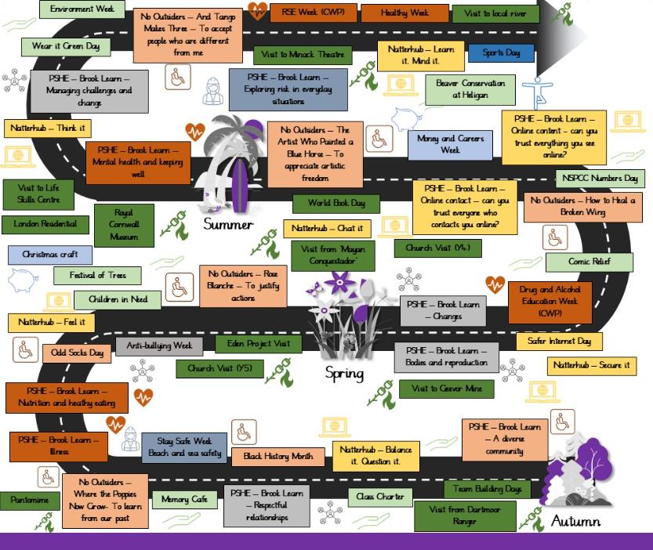

Special to Year 4/5
There was an information session last year about key skills and how you can help at home. We will let you know if this is planned for this year.
Extra Trips
Visitors
Real life experiences
Residential

Slide 9
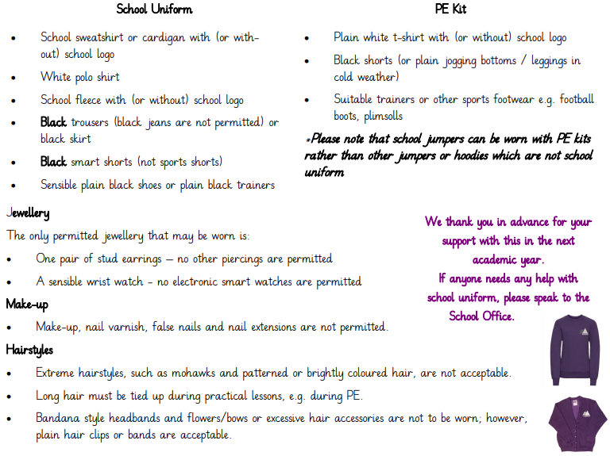
Uniform
School shoes or plain black trainers.
PE kit must be uniform not other clothes. (Can be bought in Asda or link on website for uniform with logos if wanted)
Phones to the office
No smart watches.

Slide 10
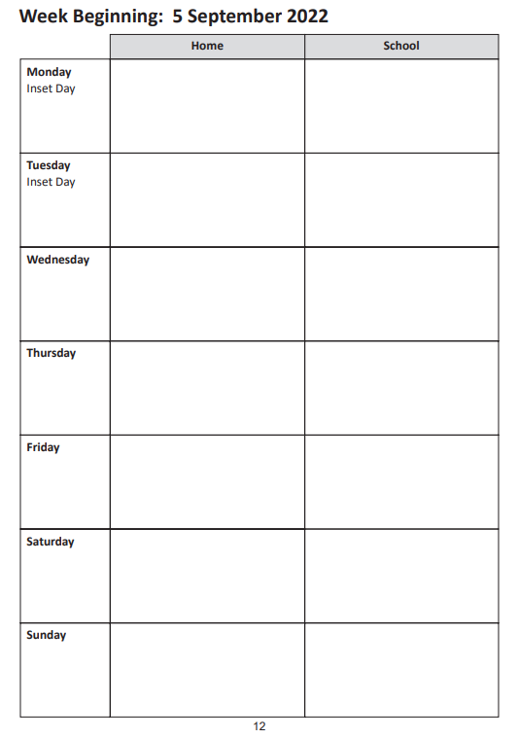
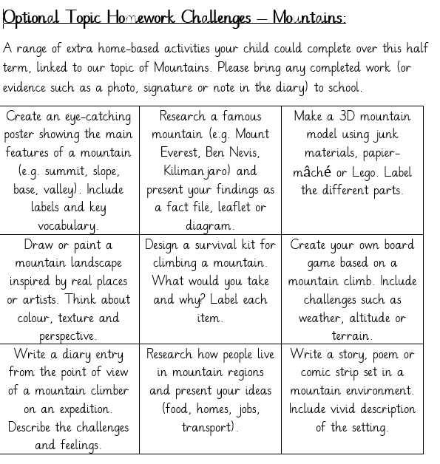
Homework
Reading expectation is daily.
Spellings are in planner
Half termly 'optional' homework grids

Slide 11




Recognition Boards, Golden Time and Rewards
Golden Time links to our recognition board and the children can earn 5 minutes per day. Holy Moley is our class reward, where the children can earn prizes for great behaviour and other positive noticing.

Slide 12
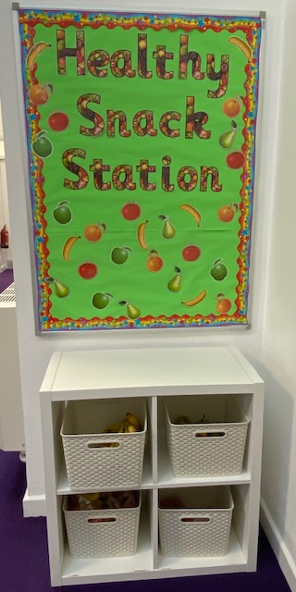

School Lunches and Healthy Tuck
School lunches are provided by Aspens and are free to all Reception, Year 1 and Year 2 children. In Key Stage 2, meals now cost £2.85
These MUST be booked in advance.
However, the school receives additional funds for children in receipt of the Pupil Premium Grant and families need to apply for this online. The school uses this to fund staffing and other activities so please apply, even if your child is in Reception to Year 2.
Link to apply: https://cornwall.cloud.servelec-synergy.com/synergyweb/FSMMain.aspx.
We also ask that children bring a healthy snack for breaktime rather than chocolate, cake, crisps or biscuits. Children will be asked to look for something healthier in their lunchbox if they have these foods or offered a piece of fruit from our fruit station. Healthy choices will be rewarded.

Slide 13
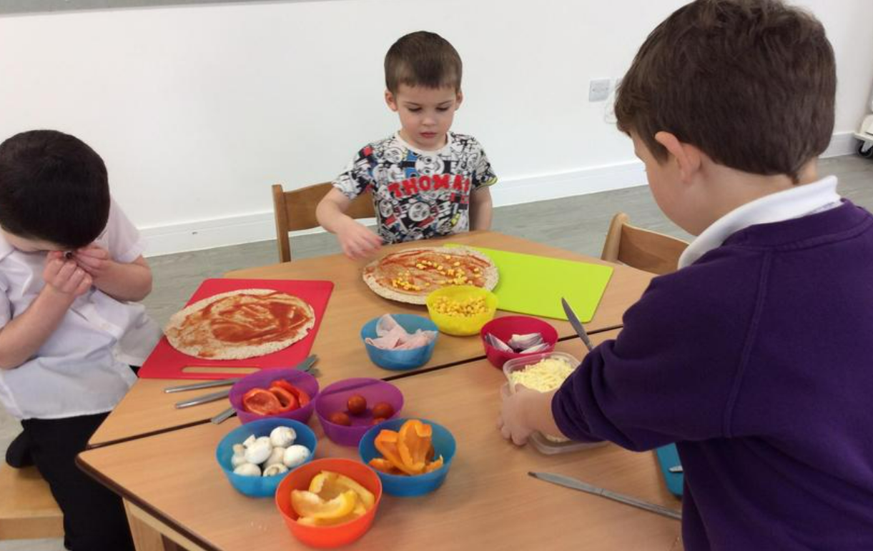
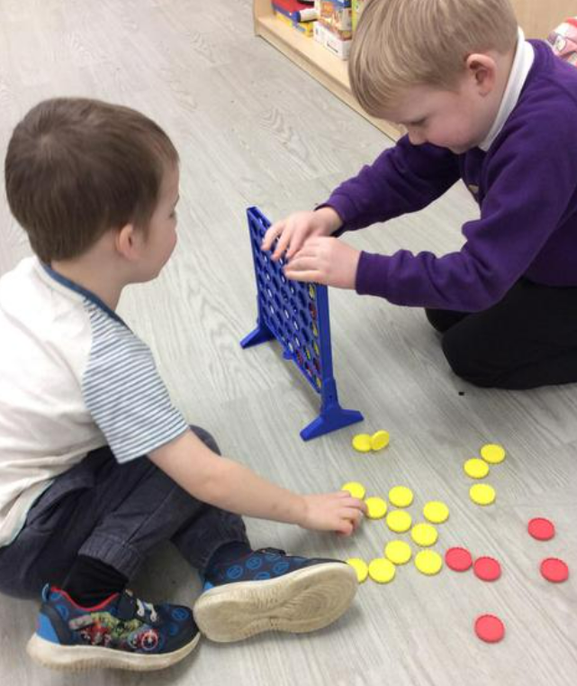
Breakfast and After School Club
The standard daily fee for attending the Breakfast Club is £3 and the After School Club is £4.50. There is a discounted rate of £4 for siblings who attend the After School Club on the same day.
Bookings are made on Arbor in advance (by 6pm the previous day) https://www.parentpay.com/.
Parents and carers can drop children to Breakfast Club at the bottom gate on School Lane from 08:00. Children have a range of games, toys, puzzles, craft materials and construction toys to play with once they have eaten their breakfast.
At After School Club, children have the same activities as Breakfast Club to choose from and there is also a daily activity planned that all children can be involved in such as a craft activity or baking. Screentime is limited to a ‘film-night’ every now and again.
Children can be collected from the same place before 17:00.

Slide 14

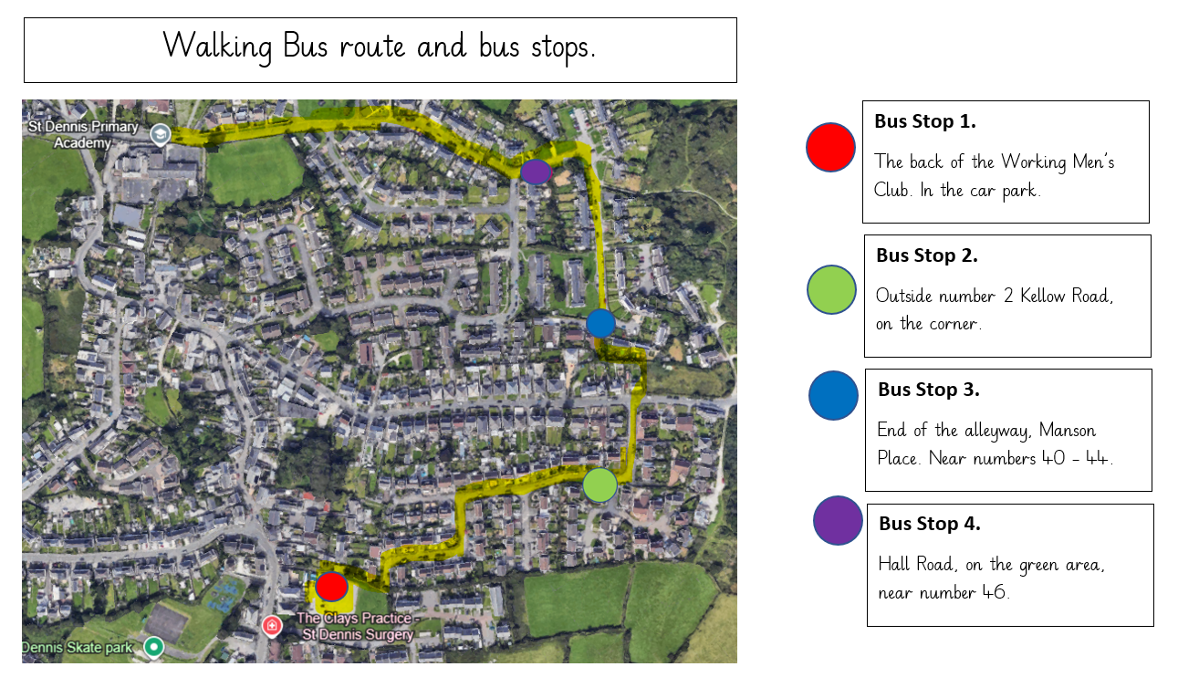
Walking Bus
Children must be booked in and any volunteers should see Mrs Bailey.
It is only Mondays to start with.
There is a link to sign up to the walking bus https://forms.cloud.microsoft/e/VsnzhGPmjm which has been shared on the Friday Update.

Slide 15
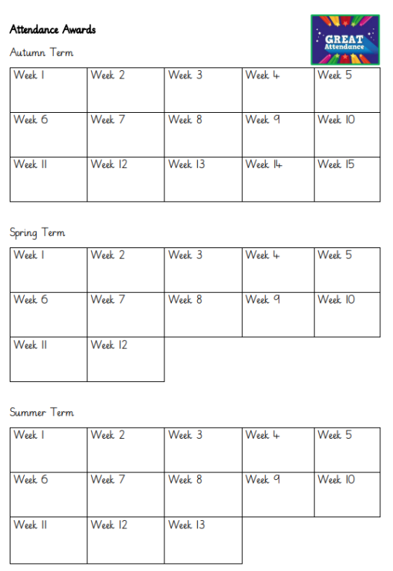
Attendance
Passports/rewards and attendance arcade.
A National Framework for Penalty Notices for school absence, including unauthorised holiday absence, was introduced following changes to the law last year.
There is a national threshold of 10 unauthorised sessions for any reason (equivalent to 5 school days) within a rolling 10 school week period for when a penalty notice must be considered.
This mean you will no longer be able to take your child out of school for one week’s holiday without the consideration of an £80 penalty notice being issued. If the fine is not paid by the first 21 days, it will rise to £160 if paid within 28 days of being issued.
If a second penalty fine is issued to the same parent for the same child within a 3-year rolling period, the fine will automatically rise to £160 with no option to pay the lower rate of £80.
If a parent then commits a third offence in a 3-year rolling period, the local authority will consider other enforcement options available to them. This could include prosecution.
There is a Leave of Absence Request form to be completed and given to Mrs Bailey before the proposed absence (a minimum of 15 days before the Leave of absence is due to commence). Each request will be considered on its own merit, but where the leave of absence could be taken outside of the school term the absence will not be authorised.
If you are worried about attendance, please contact us to arrange a meeting with Mrs Nash (Attendance Lead) to discuss how we can support you to improve the situation.

Slide 16
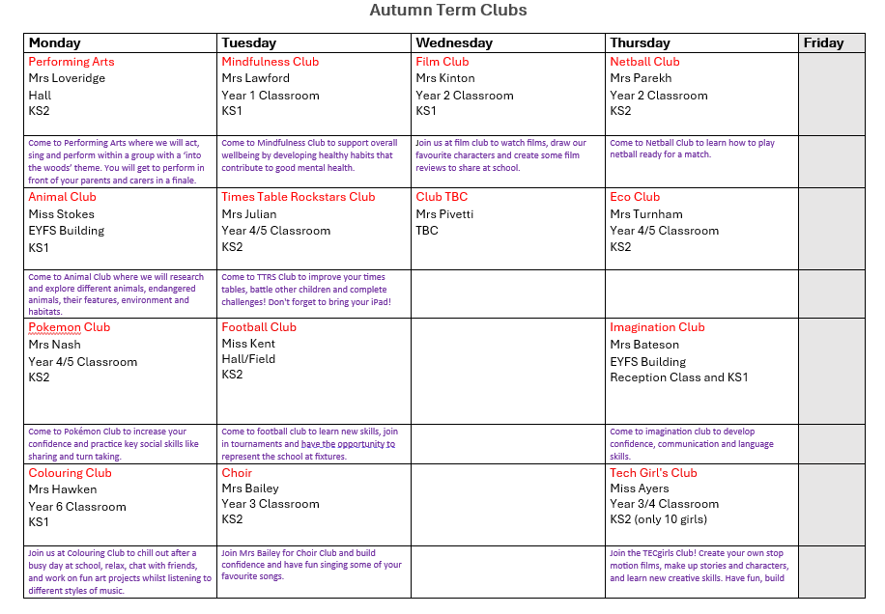
After School Clubs
Behaviour expectations at clubs are the same as in class.
Clubs finish at 4.15, unless otherwise stated
2 more clubs to be added this term, so watch this space...

Slide 17


Communication
Weekly 'head's up' - all dates and information on here
Texts and email from the School Office
Facebook​ posts, including class news
Planners
‘Coffee and Cake’ - Topics for these are gratefully received!

Slide 18
And finally!
Open door policy - Please come and speak to us if you have any questions or concerns.
Any questions?
Thank you for coming!

