Slide 1
Meet the Teacher
Year 6
2025 - 2026

Slide 2
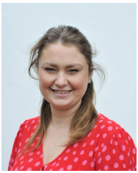
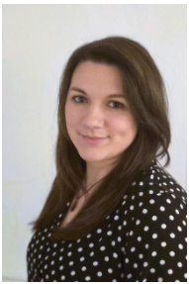

Year 6 Team
Teachers: Miss Rollason
Teaching Assistants: Mrs Bishop and Mrs Julian

Slide 3
Year 6 Topics
Autumn 1: Why is Earth so angry?
Autumn 2: How was the Battle of Britain a turning point in WW11?
Spring 1: Do we agree with Darwin’s theory of evolution?
Spring 2 and Summer 1:
What were the Ancient Egyptian’s most significant achievements?
Summer 2: Why is the fishing industry so important to local communities?
Notes:
Add in Big Questions and talk about key learning / visits / real life experiences etc with alongside these. Talk about Stunning Starts and what Fab Finishes they will be invited to

Slide 4
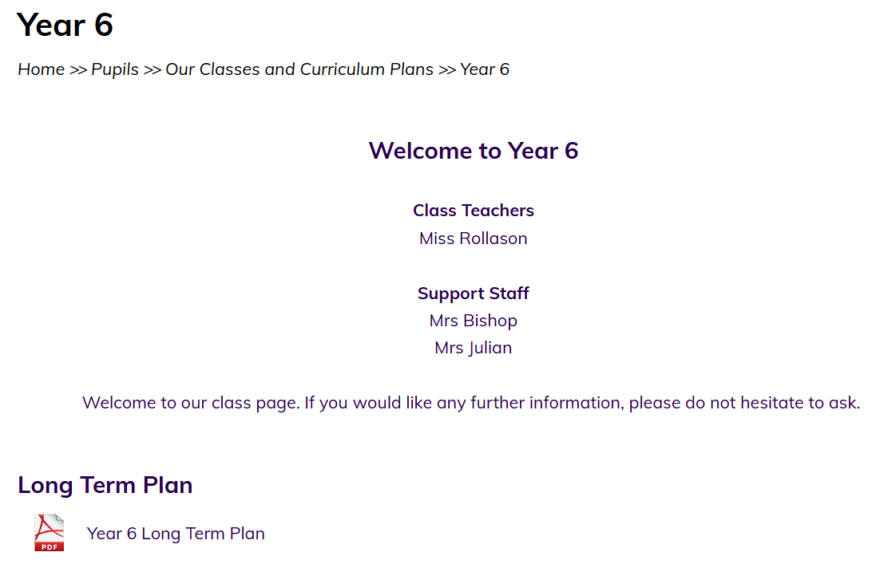

Website
Our class website page has all our plans for the coming term and Knowledge Organisers with key learning. You will also receive a paper copy of these.

Slide 5
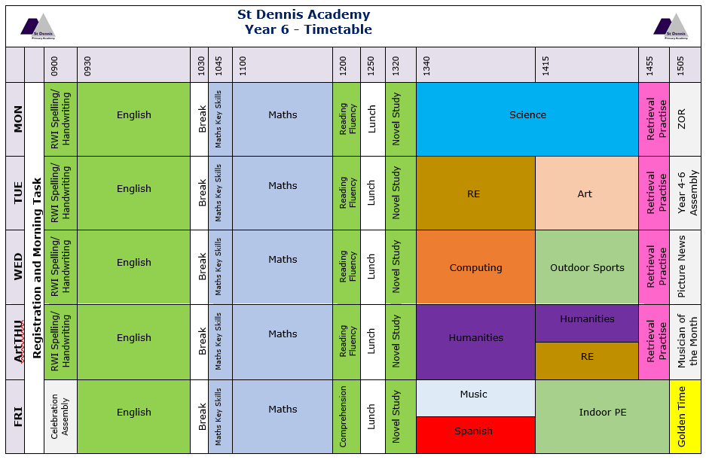
Timetable

Slide 6
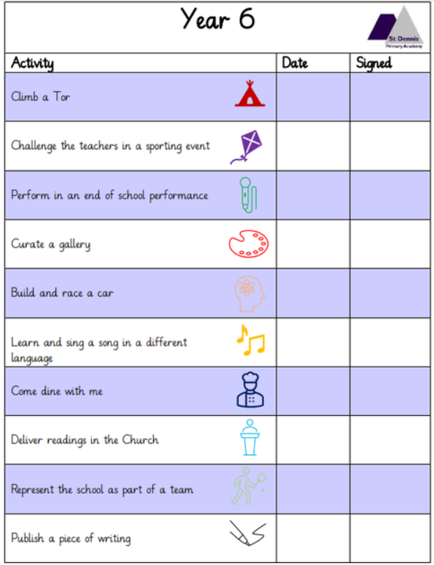
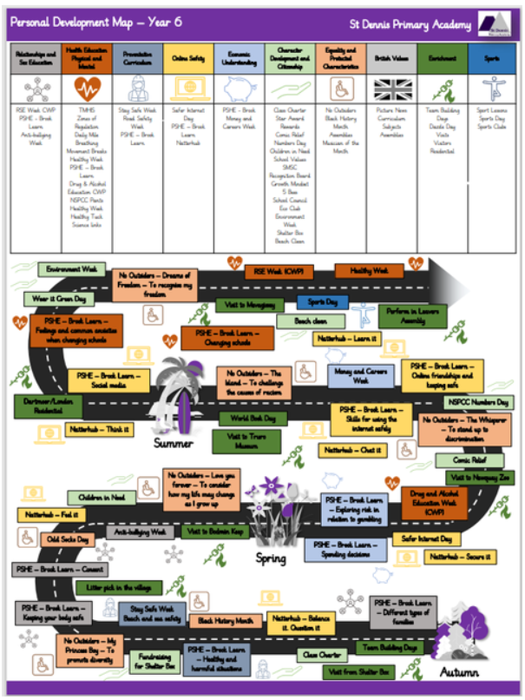
Special to Year 6
Notes:
Residentials – rough costings and details. Letters will go out by the end of the month to enable payment plans to be set up (Y4-6)
Trips etc
Tests / assessments and dates for these – information sessions to follow this year about these and how you can help at home
Also show personal development map – They are in Enrichment maps on the OneDrive

Slide 7




Special to Year 6
Week commencing 11th May 2026

Slide 8
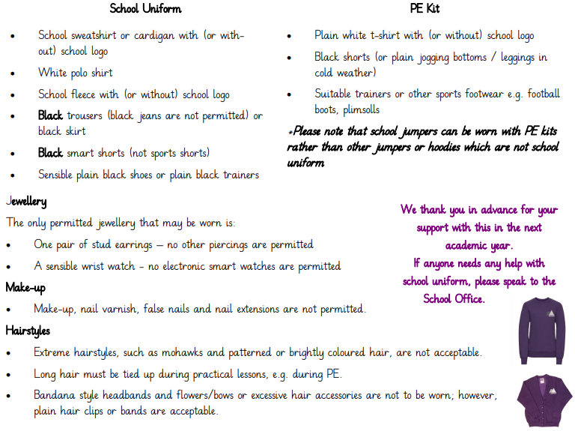
Uniform
Notes:
Go through this - especially school shoes or plain black trainers and PE kit MUST be uniform not other clothes.
Can be bought in Asda or link on website for uniform with logos if wanted
Remind parents that if they need help, to just let us know.

Slide 9
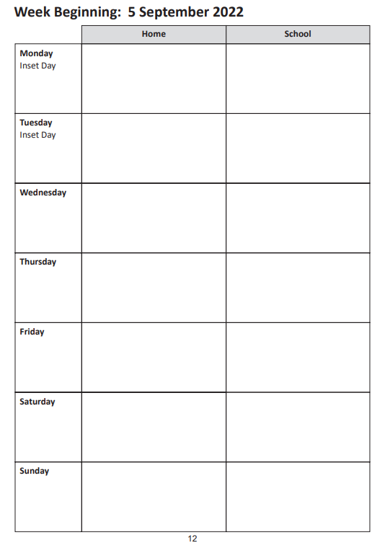
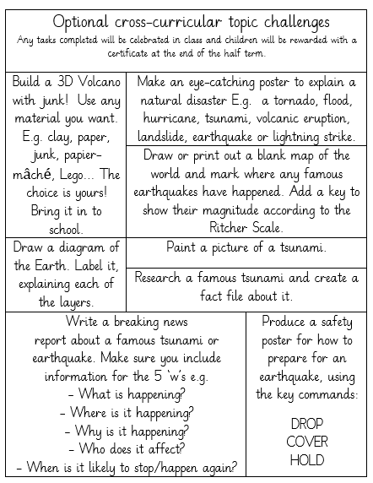
Homework
Additional revision homework for Y6:
Starting after October half term, the children will receive a piece of grammar or maths homework each week.
Notes:
Reading expectation is daily spellings can be found in the reading record. and other homework from policy including optional tasks
Snip your homework topics for this half term here

Slide 10

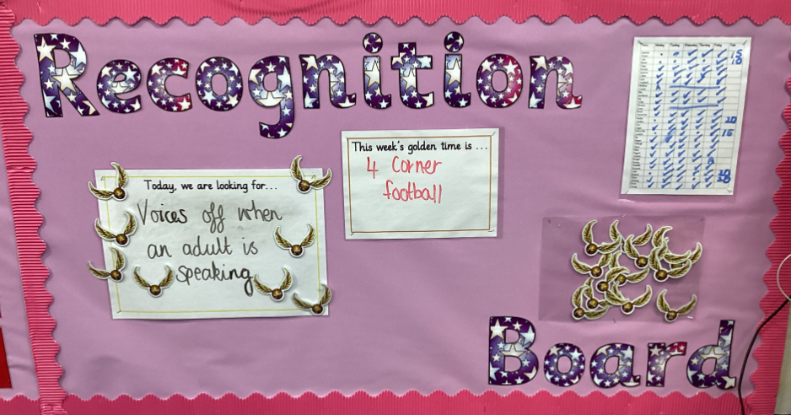


Recognition Boards, Golden Time and Rewards

Slide 11
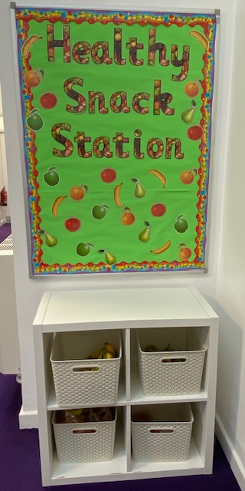

School Lunches and Healthy Tuck
School lunches are provided by Aspens and are free to all Reception, Year 1 and Year 2 children. In Key Stage 2, meals now cost £2.75.
These MUST be booked in advance.
However, the school receives additional funds for children in receipt of the Pupil Premium Grant and families need to apply for this online. The school uses this to fund staffing and subsidies towards residentials etc so please apply, even if your child is in Reception to Year 2.
Link to apply: https://cornwall.cloud.servelec-synergy.com/synergyweb/FSMMain.aspx.
We also ask that children bring a healthy snack for breaktime rather than chocolate, cake, crisps or biscuits. Children will be asked to look for something healthier in their lunchbox if they have these foods or offered a piece of fruit from our fruit station. Healthy choices will be rewarded.

Slide 12
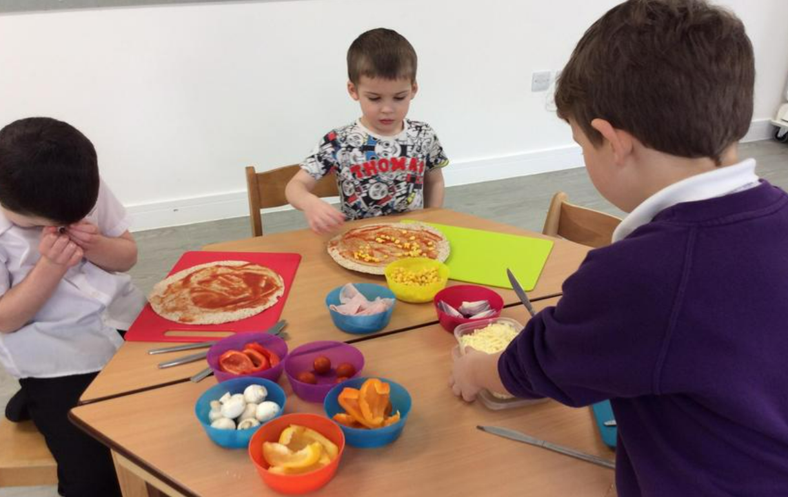
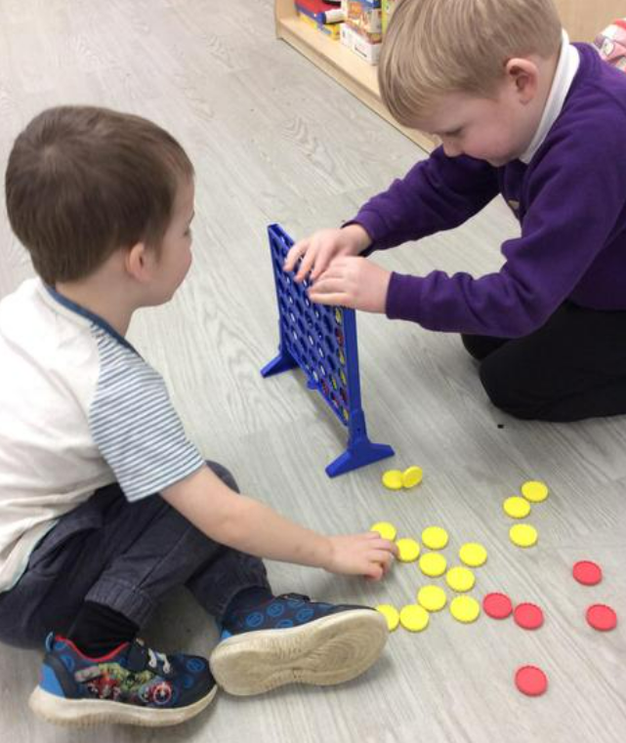
Breakfast and After School Club
The standard daily fee for attending the Breakfast Club is £3 and the After School Club is £4.50. There is a discounted rate of £4 for siblings who attend the After School Club on the same day.
Bookings are made on Arbor in advance (by 6pm the previous day) https://www.parentpay.com/.
Parents and carers can drop children to Breakfast Club at the bottom gate on School Lane from 08:00. Children have a range of games, toys, puzzles, craft materials and construction toys to play with once they have eaten their breakfast.
At After School Club, children have the same activities as Breakfast Club to choose from and there is also a daily activity planned that all children can be involved in such as a craft activity or baking. Screentime is limited to a ‘film-night’ every now and again.
Children can be collected from the same place before 17:00.

Slide 13
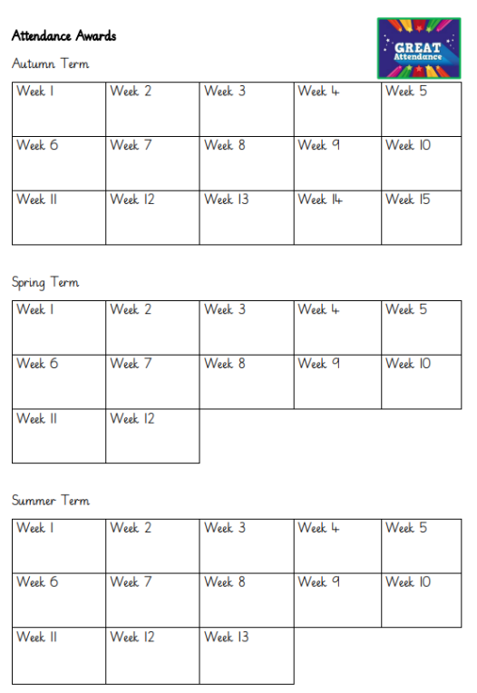
Attendance
Show a passport and explain how the rewards will work
A National Framework for Penalty Notices for school absence, including unauthorised holiday absence, was introduced following changes to the law last year.
There is a national threshold of 10 unauthorised sessions for any reason (equivalent to 5 school days) within a rolling 10 school week period for when a penalty notice must be considered.
This mean you will no longer be able to take your child out of school for one week’s holiday without the consideration of an £80 penalty notice being issued. If the fine is not paid by the first 21 days, it will rise to £160 if paid within 28 days of being issued.
If a second penalty fine is issued to the same parent for the same child within a 3-year rolling period, the fine will automatically rise to £160 with no option to pay the lower rate of £80.
If a parent then commits a third offence in a 3-year rolling period, the local authority will consider other enforcement options available to them. This could include prosecution.
There is a Leave of Absence Request form to be completed and given to Mrs Brokenshire before the proposed absence (a minimum of 15 days before the Leave of absence is due to commence). Each request will be considered on its own merit, but where the leave of absence could be taken outside of the school term the absence will not be authorised.
If you are worried about attendance, please contact us to arrange a meeting with Mrs Nash (Attendance Lead) to discuss how we can support you to improve the situation.

Slide 14
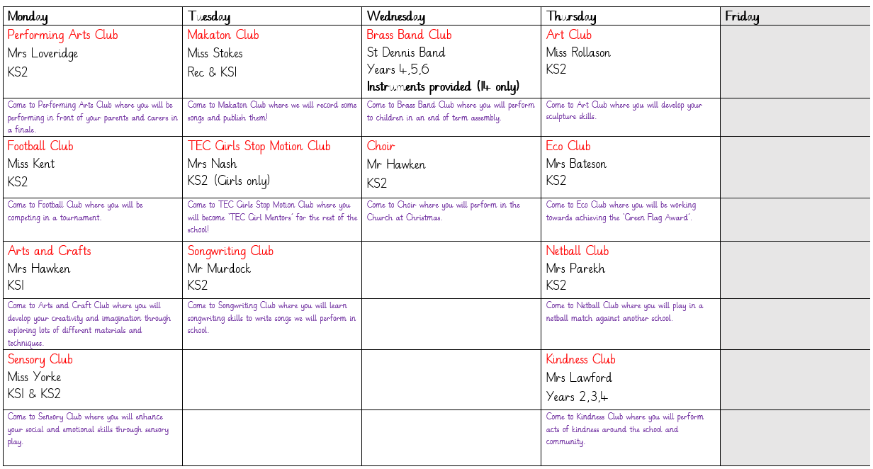
After School Clubs

Slide 15

Communication
St Dennis News every Friday​ - all dates and information on here
Text and email from the School Office
Facebook​
Class newsletters every Friday
Planners
‘Coffee and Cake’ - Topics for these are gratefully received!

Slide 16
And finally!
Open door policy - Please come and speak to us if you have any questions or concerns.
Any questions?
Thank you for coming!

