Slide 1
Meet the Teacher
Reception
2026 - 2027

Slide 2
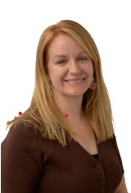
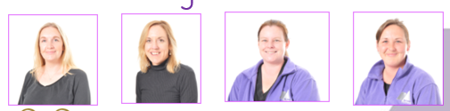
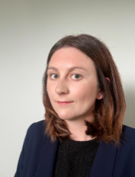
Reception Team
Head teacher: Mrs Bailey
Teachers: Miss Stokes and Mrs Bateson
Teaching Assistants: Miss Caust , Mrs Casper and Mrs Pivetti

Slide 3
Reception Topics
Autumn 1: What happens at school?
Autumn 2: What is a hero?
Spring 1: Which animal is the best?
Spring 2: Where do I live?
Summer 1: What’s the best way to travel?
Summer 2: What’s on my plate?
.

Slide 4
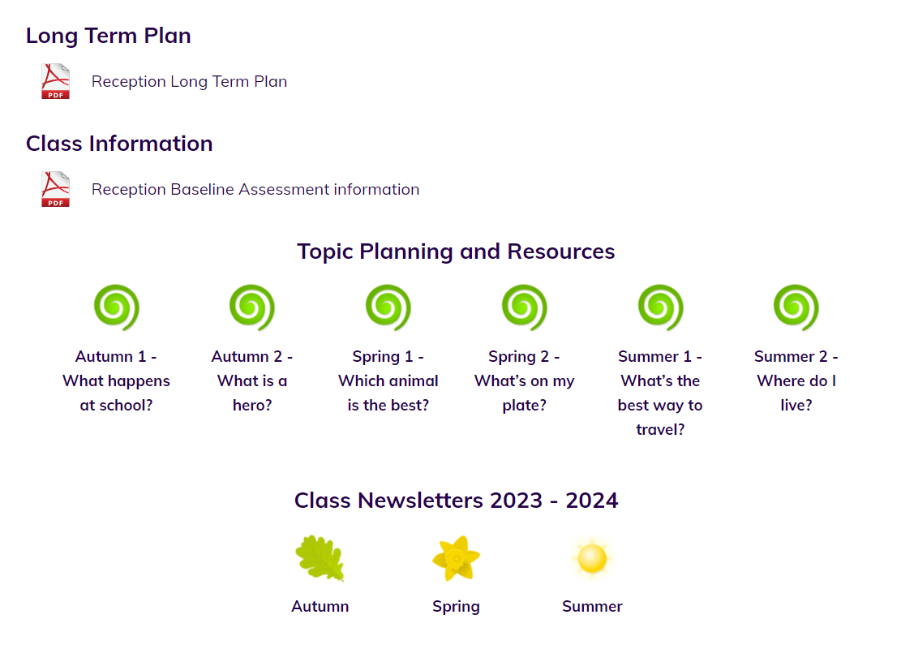

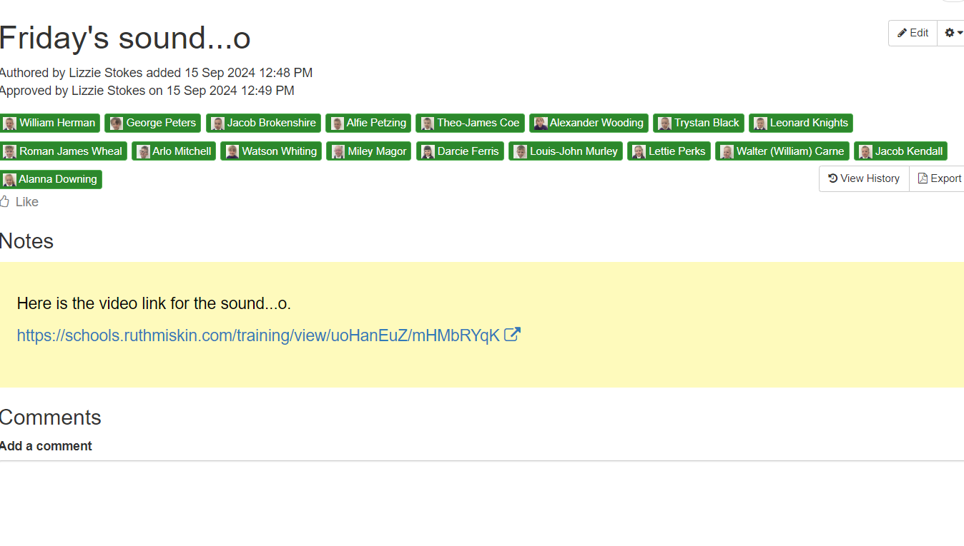
Website
  Our class website page has all our plans for the coming term; there are half termly newsletters and weekly Facebook updates with information about key learning. We will also share key information on Tapestry.

Slide 5
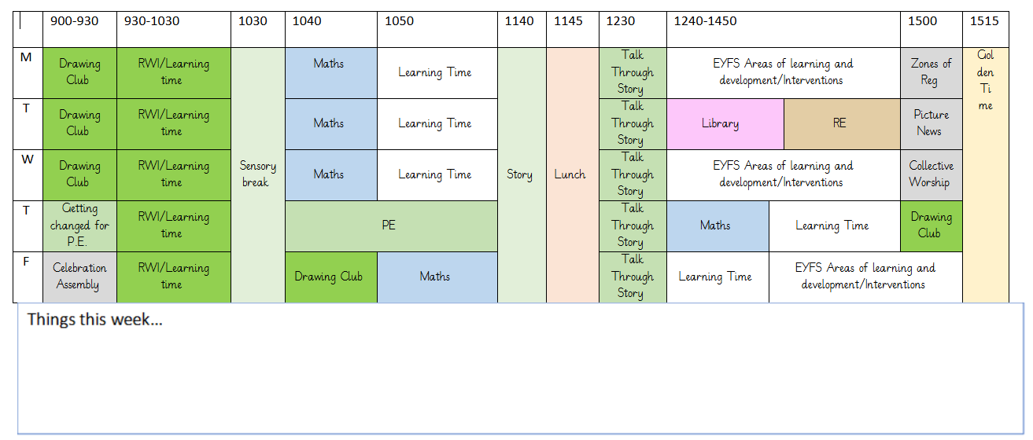
Timetable

Slide 6
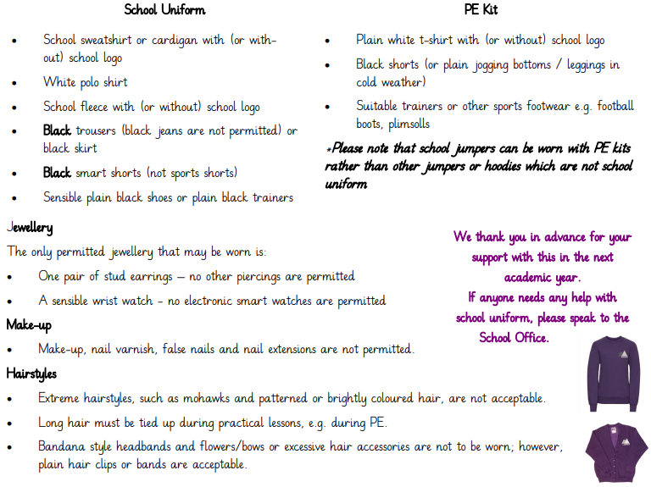
Uniform
.

Slide 7
Special to Reception class
Our educational visits are bigger and better this academic year, thanks to funding from the Clore Duffield Foundation. They help children access enriching experiences that they might otherwise not have the opportunity to enjoy. The funding covers the full cost of participating trips.
For our children, this means more opportunities to learn beyond the classroom, experience arts, culture, heritage, science and the natural world, and make memorable experiences together.

Slide 8
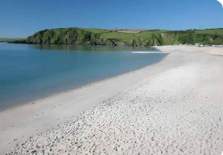

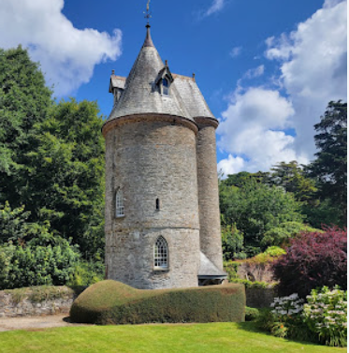
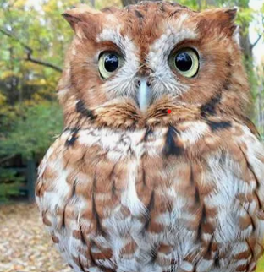
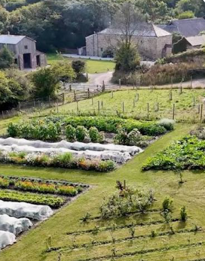
Special to Reception class
Our planned visits for 2026–27 include:
a whole school trip to the pantomime
a trip to the Screech Owl Sanctuary
a trip to a National Trust Garden
a trip to Nancarrow farm
a trip to the beach

Slide 9
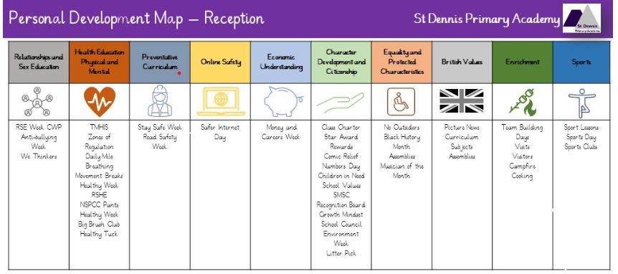
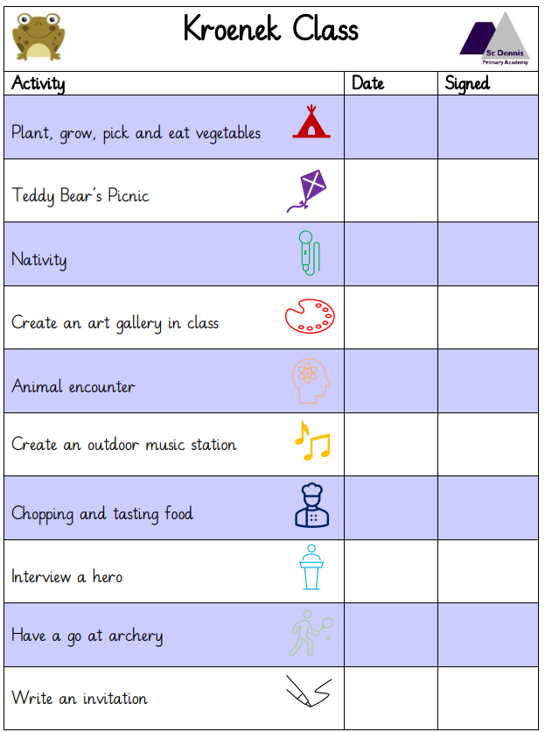
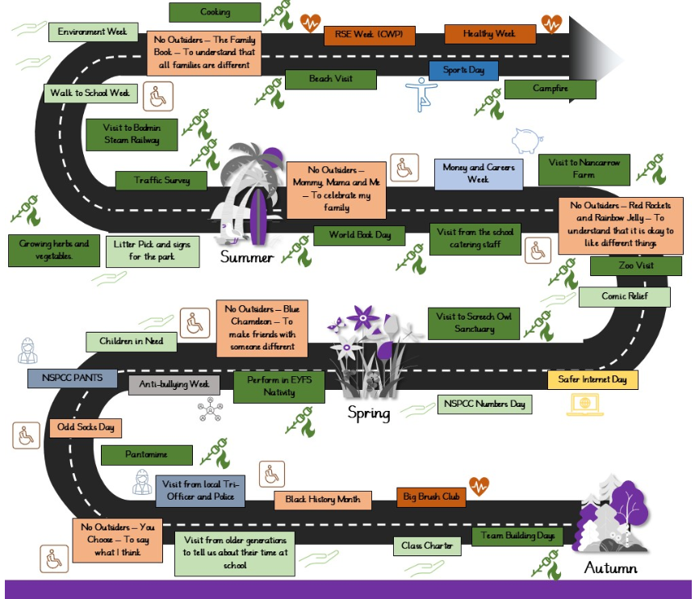
Special to Reception Class
Baseline assessments
Wellcomm assessments
Visitors
Visits from/to the Emergency Services
Visit from a ‘super- hero’
Visit to Newquay Zoo
Cooking
Walks around the village to map our local area
Nature walk
Talk from the school cooks
Visit older generations

Slide 10
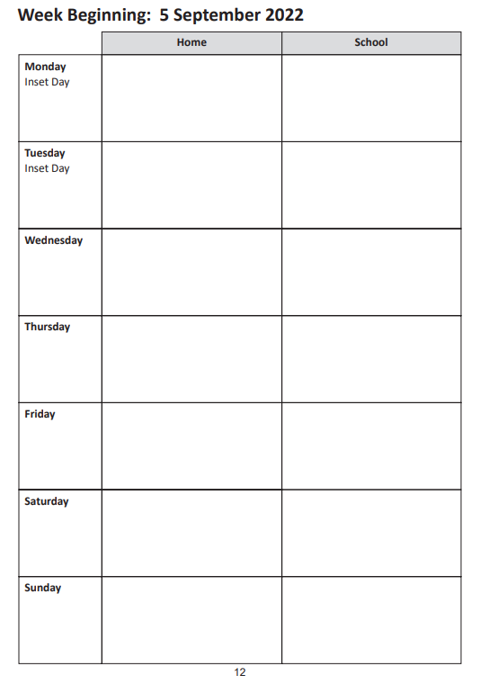

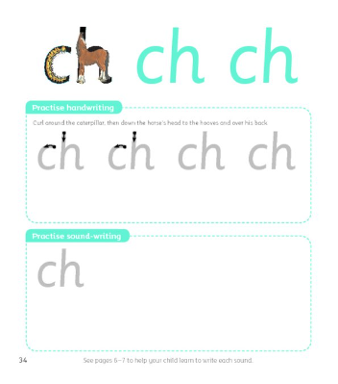

Homework

Slide 11
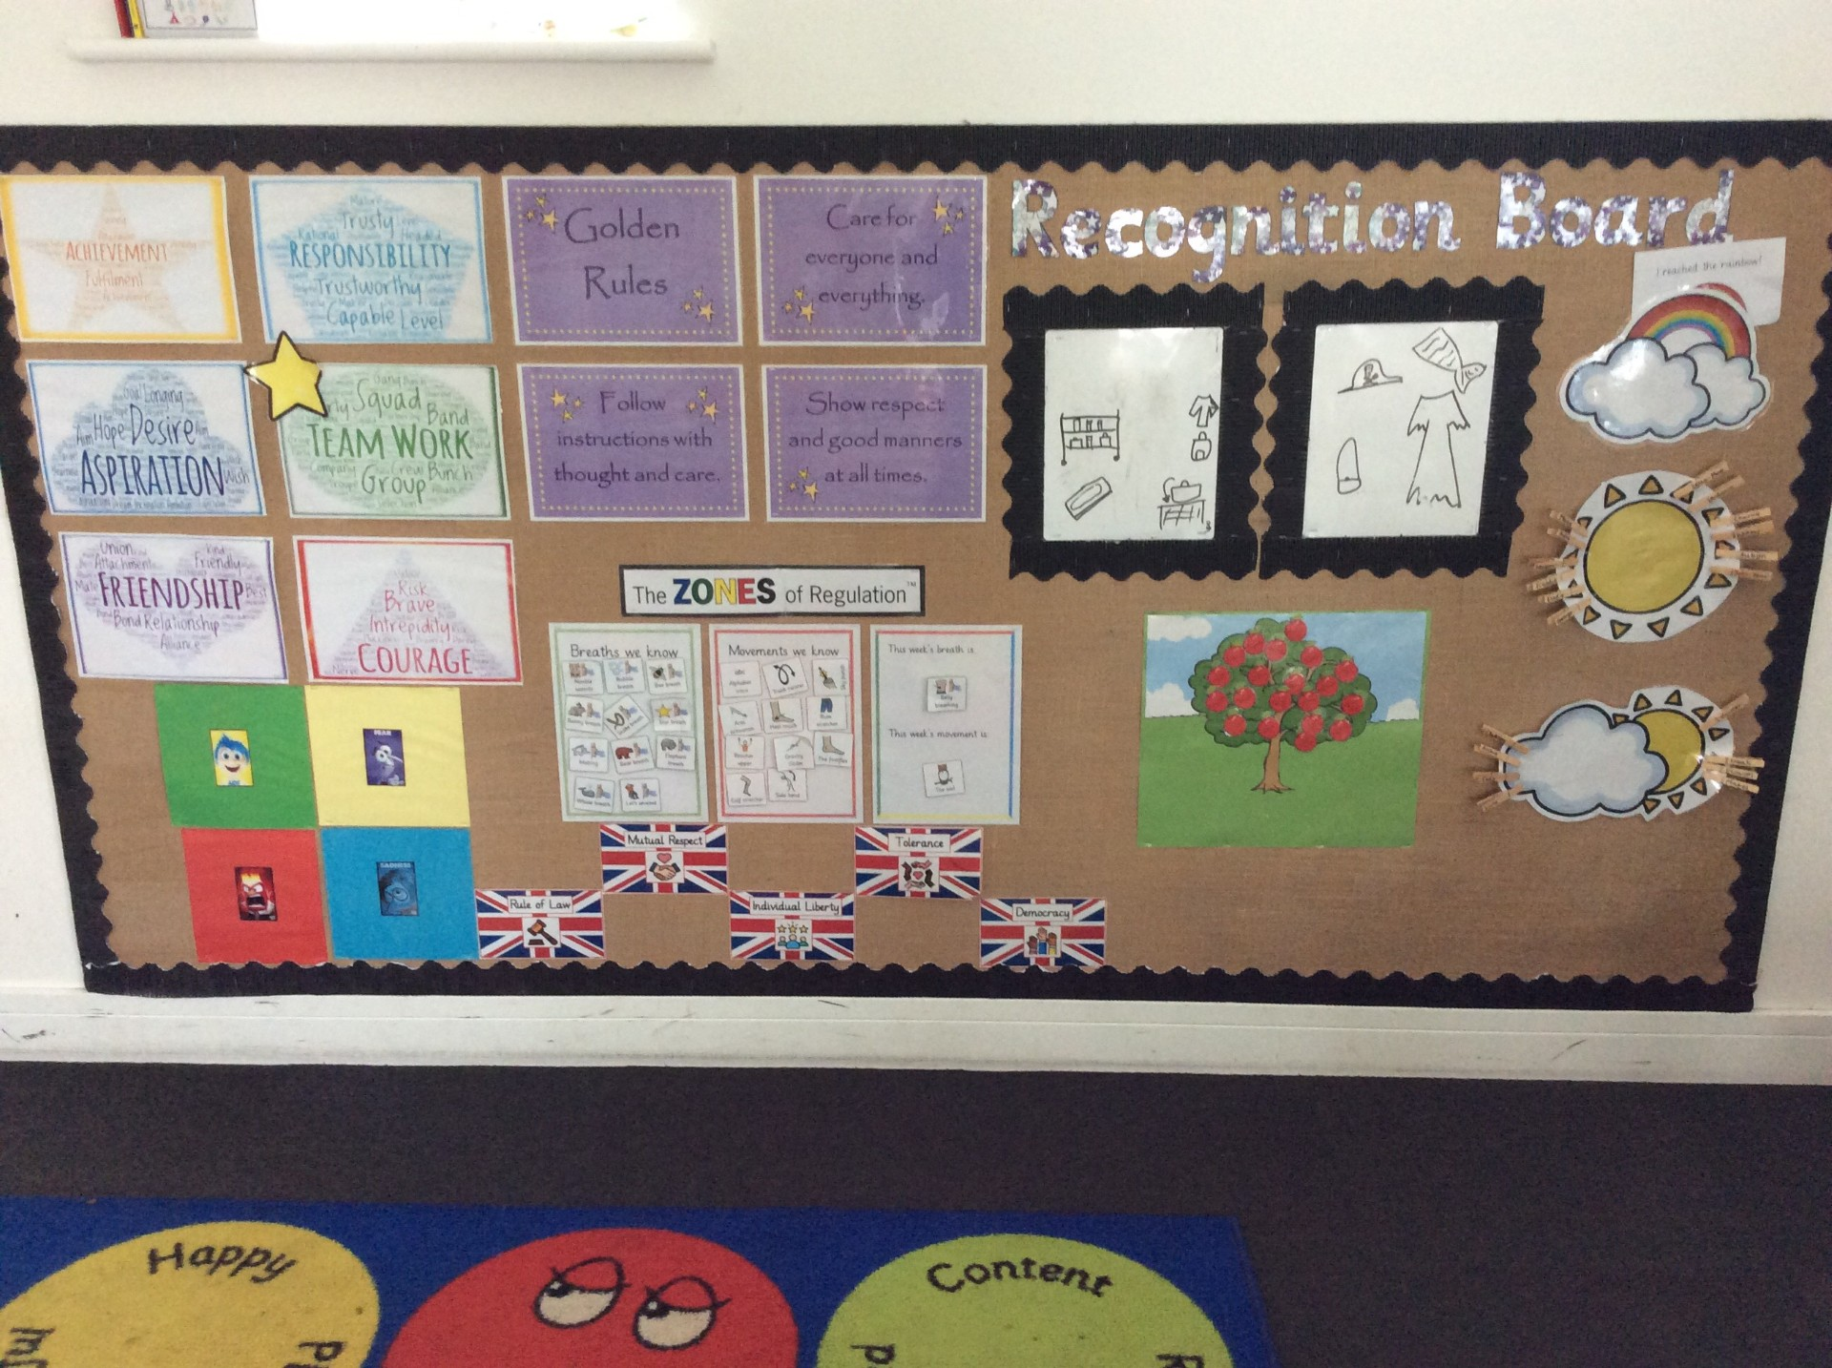



Recognition Boards, Golden Time and Rewards

Slide 12
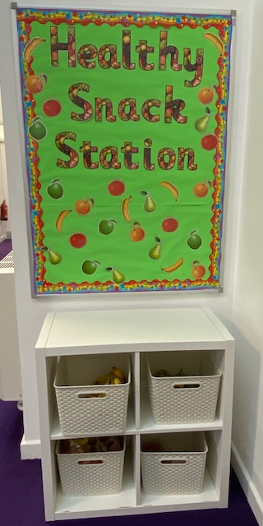

School Lunches and Healthy Tuck
School lunches are provided by Aspens and are free to all Reception, Year 1 and Year 2 children. In Key Stage 2, meals now cost £2.85
These MUST be booked in advance.
However, the school receives additional funds for children in receipt of the Pupil Premium Grant and families need to apply for this online. The school uses this to fund staffing and other activities so please apply, even if your child is in Reception to Year 2.
Link to apply: https://cornwall.cloud.servelec-synergy.com/synergyweb/FSMMain.aspx.
We also ask that children bring a healthy snack for breaktime rather than chocolate, cake, crisps or biscuits. Children will be asked to look for something healthier in their lunchbox if they have these foods or offered a piece of fruit from our fruit station. Healthy choices will be rewarded.

Slide 13
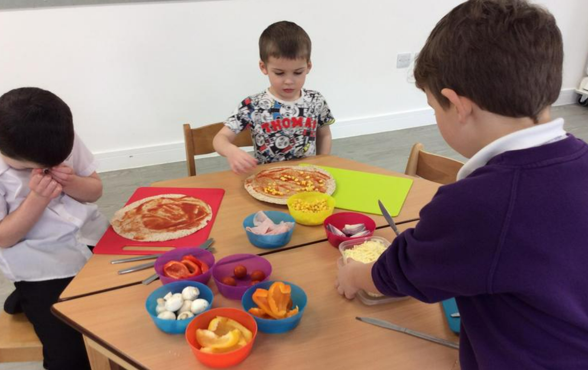
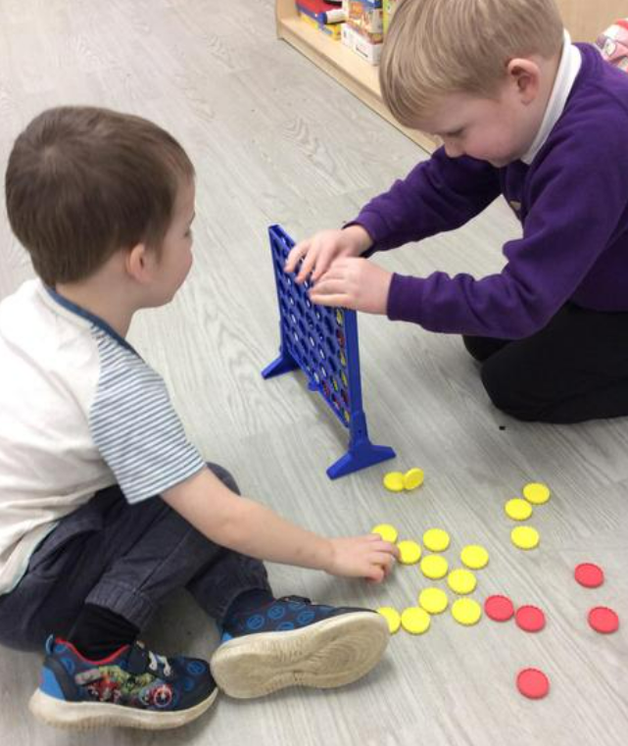
Breakfast and After School Club
The standard daily fee for attending the Breakfast Club is £3 and the After School Club is £4.50. There is a discounted rate of £4 for siblings who attend the After School Club on the same day.
Bookings are made on Arbor in advance (by 6pm the previous day) https://www.parentpay.com/.
Parents and carers can drop children to Breakfast Club at the bottom gate on School Lane from 08:00. Children have a range of games, toys, puzzles, craft materials and construction toys to play with once they have eaten their breakfast.
At After School Club, children have the same activities as Breakfast Club to choose from and there is also a daily activity planned that all children can be involved in such as a craft activity or baking. Screentime is limited to a ‘film-night’ every now and again.
Children can be collected from the same place before 17:00.

Slide 14

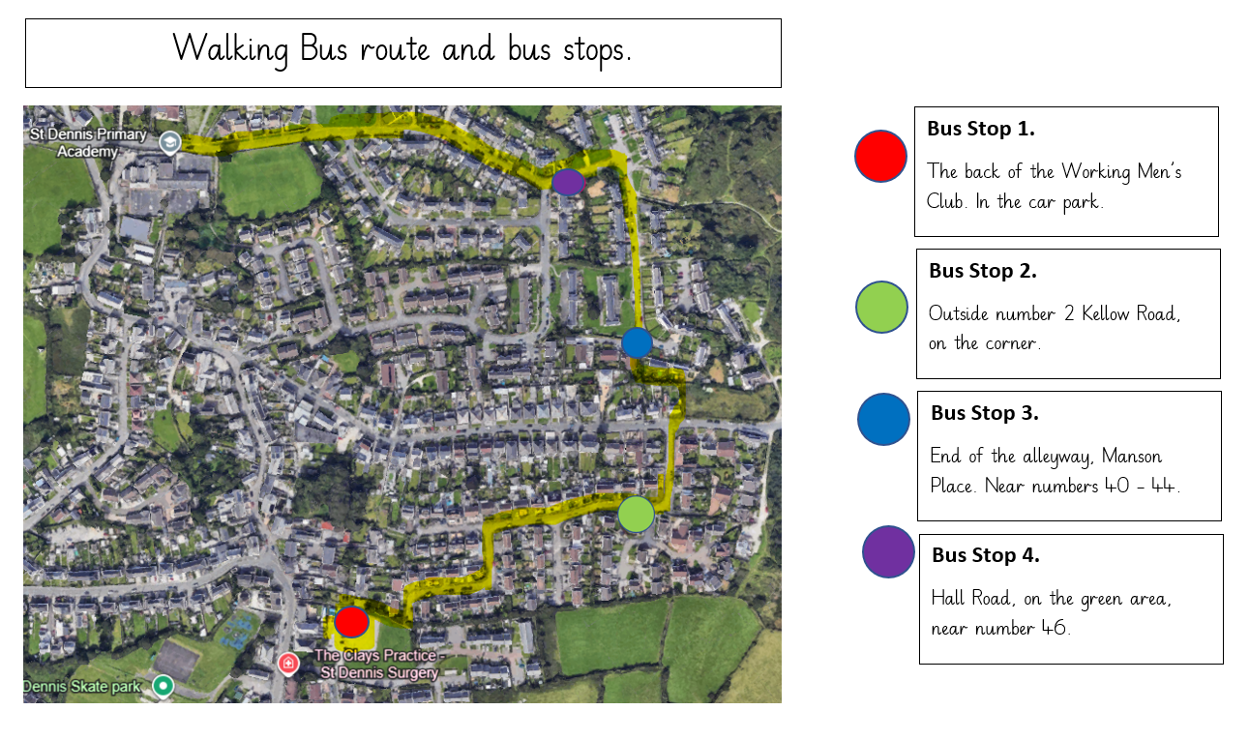
Walking Bus
Explain the procedure (click on the link below) and how it works and that children must be booked in and any volunteers should see Mrs Bailey!
It is only Mondays to start with!!
There is a link to sign up to the walking bus https://forms.cloud.microsoft/e/VsnzhGPmjm which has been shared on the Friday Update.

Slide 15
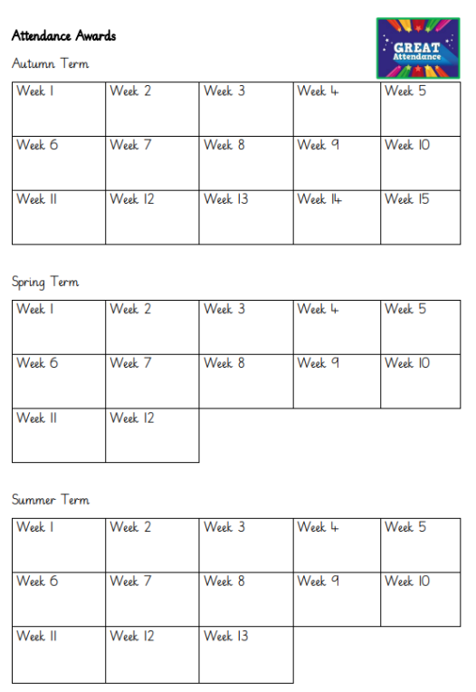
Attendance
Show a passport and explain how the rewards and attendance arcade works
A National Framework for Penalty Notices for school absence, including unauthorised holiday absence, was introduced following changes to the law last year.
There is a national threshold of 10 unauthorised sessions for any reason (equivalent to 5 school days) within a rolling 10 school week period for when a penalty notice must be considered.
This mean you will no longer be able to take your child out of school for one week’s holiday without the consideration of an £80 penalty notice being issued. If the fine is not paid by the first 21 days, it will rise to £160 if paid within 28 days of being issued.
If a second penalty fine is issued to the same parent for the same child within a 3-year rolling period, the fine will automatically rise to £160 with no option to pay the lower rate of £80.
If a parent then commits a third offence in a 3-year rolling period, the local authority will consider other enforcement options available to them. This could include prosecution.
There is a Leave of Absence Request form to be completed and given to Mrs Bailey before the proposed absence (a minimum of 15 days before the Leave of absence is due to commence). Each request will be considered on its own merit, but where the leave of absence could be taken outside of the school term the absence will not be authorised.
If you are worried about attendance, please contact us to arrange a meeting with Mrs Nash (Attendance Lead) to discuss how we can support you to improve the situation.

Slide 16
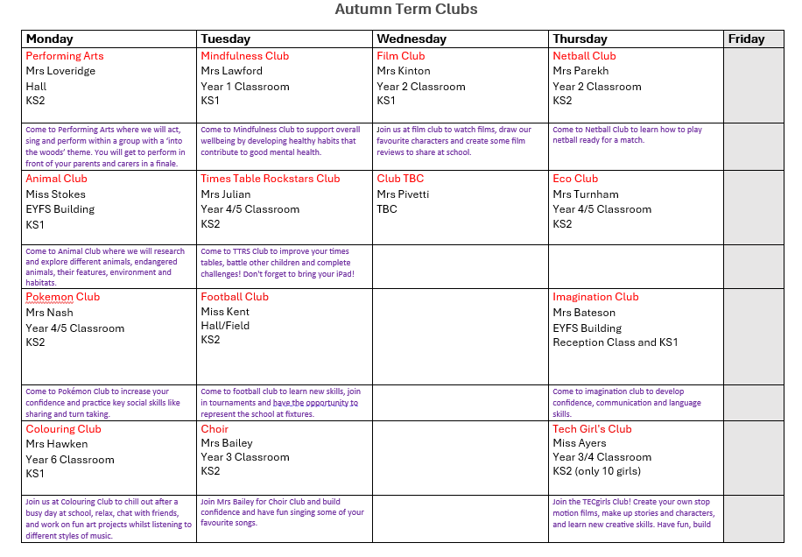
After School Clubs
Remind about behaviour expectations at clubs and that clubs finish at 4.15, unless otherwise stated

Slide 17


Communication
Weekly 'head's up' - all dates and information on here
Texts and email from the School Office
Facebook​ posts, including class news
Planners
‘Coffee and Cake’ - Topics for these are gratefully received!

Slide 18
And finally!
Open door policy - Please come and speak to us if you have any questions or concerns.
Any questions?
Thank you for coming!

